Slide 1
Contemporary Tourism
Governing the Contemporary Tourism Product

Slide 2
Lecture Objectives
Understand the development of the concept of governance and its key characteristics
Understand the reorganisation of the state
Recognise the importance of multi-level governance, particularly in policy areas that have become highly globalised
Appreciate the complexity of governance in contemporary tourism
Understand the major roles of government in contemporary tourism
Identify different types of tourism policy

Slide 3
Governance
Designing and implementing public policy and strategy for tourism
Coordination of government, private sector and non-government actors
All scales
Shift from government to governance
Nation state is important in tourism

Slide 4
Governance in Tourism
Governance as the act of governing
A major concern to stakeholders in tourism
The design, implementation and monitoring of public policies and strategies with respect to how the state intervenes in tourism
Corporate governance is related to but separate from state governance

Slide 5
From Government to Governance
Role of government and the state has changed in many economically developed countries
Complex elements of governance
Role of State
Sub national (local state)
Supra-national organizations (e.g. EU)
Trans-territorial organizations (cross-border)
State remains important. State has power to change how it governs.

Slide 6
Elements of Contemporary Governance
change in political practices involving, amongst other things:
increasing globalisation
the rise of networks that cross the public-private divide
the marketization and corporatisation of the state
increasing institutional fragmentation

Slide 7
Scales
Multi-level governance
International
Complex
Policy fields that are internationalized and have “stretched” state governance include
aviation
the environment
human rights
international trade
migration

Slide 8
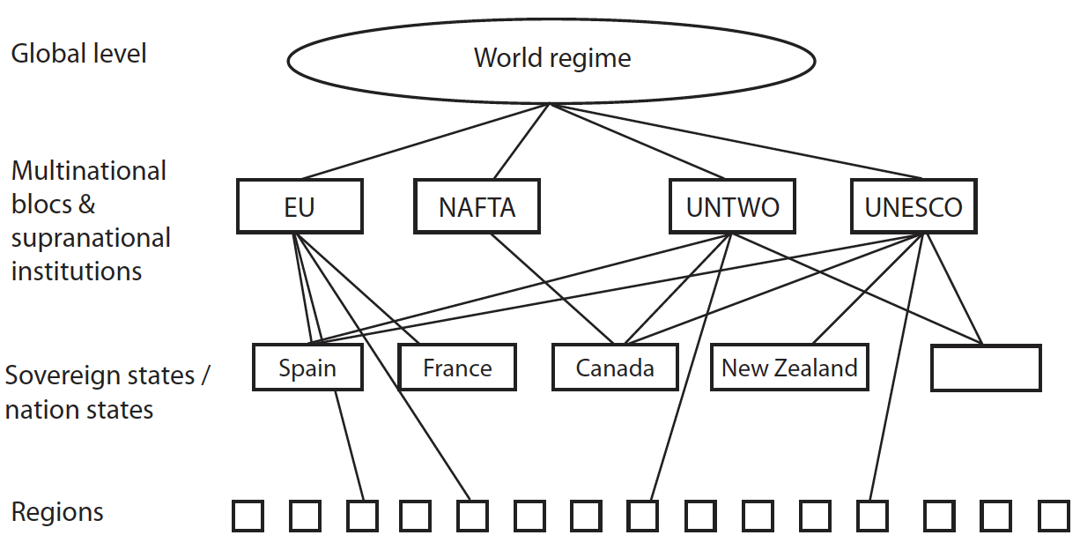
Multi-level governance

Slide 9
Roles of Government in Tourism
Varies by scale
Varies by jurisdiction
Changes over time
Roles
Coordination
Planning
Regulation
Entrepreneurship
Stimulation
Promotion
Overall role of protecting the public interest

Slide 10
Types of Regulation
Policy types:
Regulatory
Self regulatory
Distributive
Re-distributive

Slide 11
Partnerships
Partnerships designed to‘steer’ policy
Suggests no single actor can solve issues in tourism
Cross sector
Potentially allows participation
Public-partnerships a major area of formal relationships

Slide 12
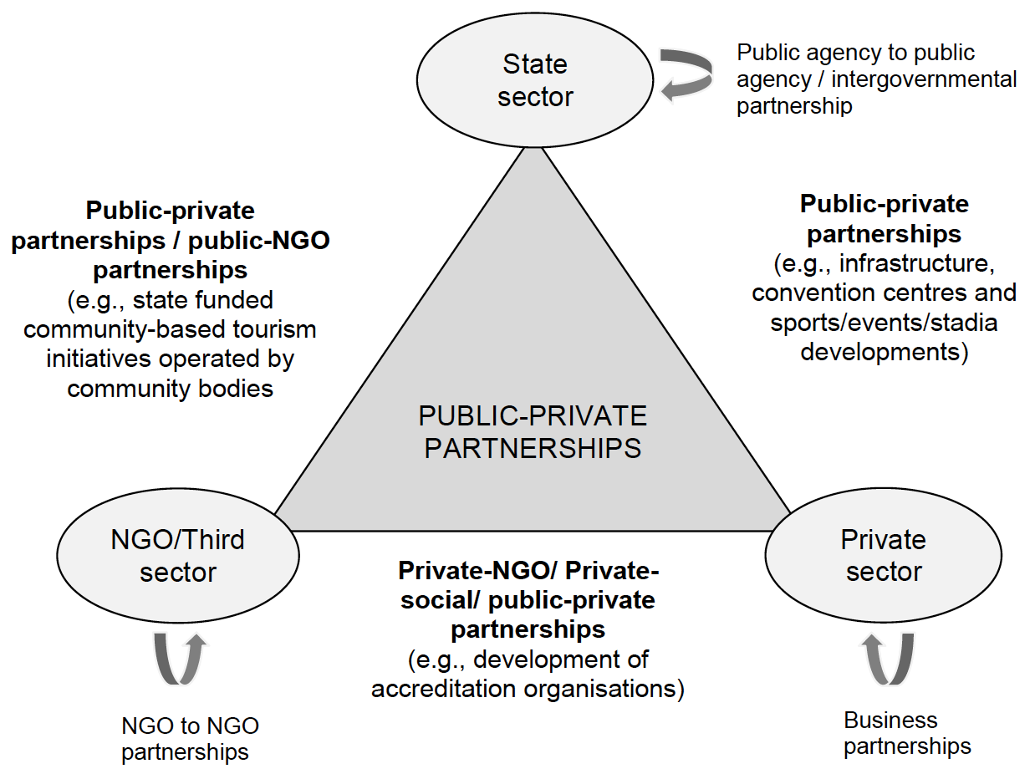
Public-Private Partnerships

Slide 13
Different partnerships
Association: Participation in an accreditation or membership-based program
Network partnerships: Separate organizational identities are maintained within a set of collaborative relationships
Sub-contract: One organization is contracted by another to implement or operate a program
Co-production: Partnership agreement (MOU), joint venture, or consortium arrangement

Slide 14
Benefits of Collaboration
Broad analysis improves the quality of solutions
Response capacity is more diversified
Useful for reopening deadlocked negotiations
Risk of impasse is minimised
Process ensures that each stakeholder’s interests are considered in any agreement
Parties retain ownership of the solution
Parties most familiar with the problem find solutions
Participation enhances acceptance of solution and willingness to implement it
Potential to develop cost-effective innovative solutions

Slide 15
Partnership structures
Critical to the collaborative process is the opportunity and capacity to participate.
Genuine partnership in tourism therefore may not mean the end of politics but instead providing a structure by which the full range of opinions and perspectives of those impacted by tourism can be heard and addressed

Slide 16
Implementation Issues of Tourism Policy
Represent compromises between conflicting values of stakeholders.
Between key stakeholders and interests within the policy development and implementation structure.
Between key stakeholders and interests upon whom implementation will have an impact.
Framed without attention being given to the way in which underlying forces (particularly economic ones) and policy decisions outside of tourism will affect them.

Slide 17
Metagovernance
A counter process to the tendencies of the “withdrawal” of the state from governance, whereby political authorities at national and other levels are more involved in organising the self-organisation of partnerships, networks and governance regimes
The governance of governance
Policy and governance failure

Slide 18
The Governance of Tourism Governance
Many studies of governance in tourism have tended to focus on the techniques or methods of governance rather than the values that may underlie the selection of particular interventions.
What values or political philosophies lead to the selection of a particular policy intervention and what was the range of choices?

Slide 19
Summary of Key Points
The changing role of government – the public sector – in governing tourism and the changing notion of governance itself.
Steering and public-private partnerships
Governance occurs over multiple scales and levels
Vital for policy and planning

